Slide 1

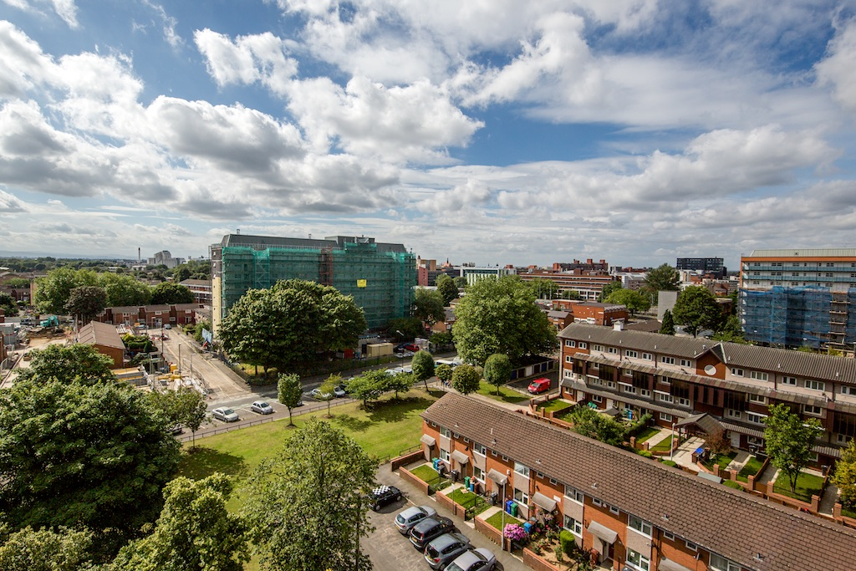
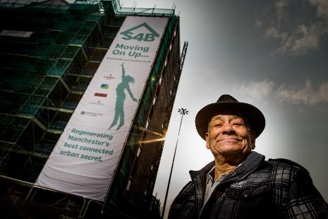

Leaseholder Information
Event 18/08/15

Slide 2
Today we will give you information on…
The benefits of the Brunswick regeneration
The refurbishment works
Service charges and your contribution to the works
Ways to pay and support available to you

Slide 3
Rules of the meeting
Please wait to ask questions after the presentation
One person to speak at a time
Speak through the Chair
Please do not raise personal issues
This is a leaseholder event so leaseholders take precedence

Slide 4
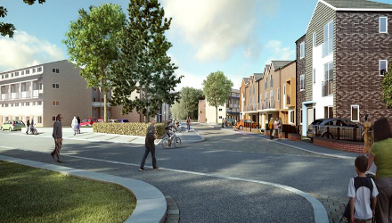
How you benefit from the regeneration of Brunswick
Improved communal areas,
Improved layout,
New shops,
Improved green spaces,
New playgrounds and allotments,
Value of properties will increase.

Slide 5
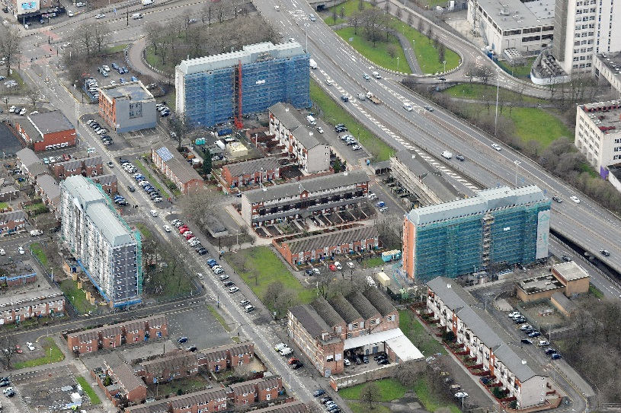
Value of homes is increasing
House prices in the North West have increased by 3.6% in the last 12 months. Properties in Manchester up by 3.1%,
A maisonette sold for £82,000 in March 2013. Zoopla now estimates the value as £92,000.

Slide 6
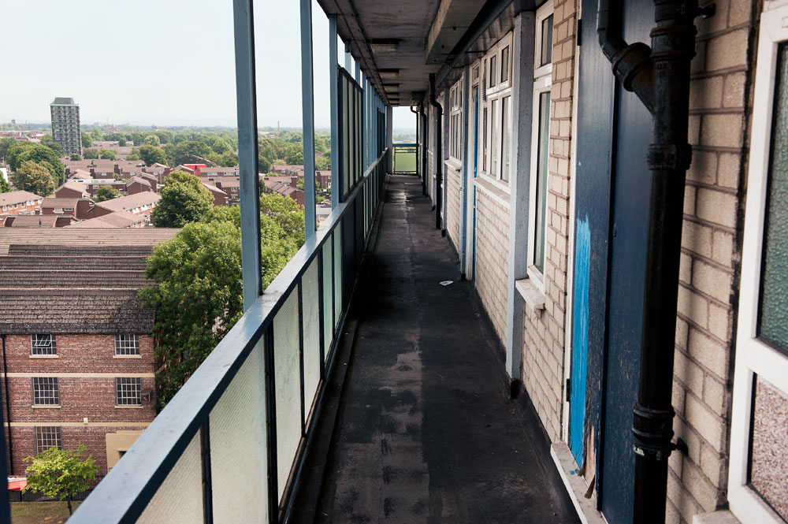
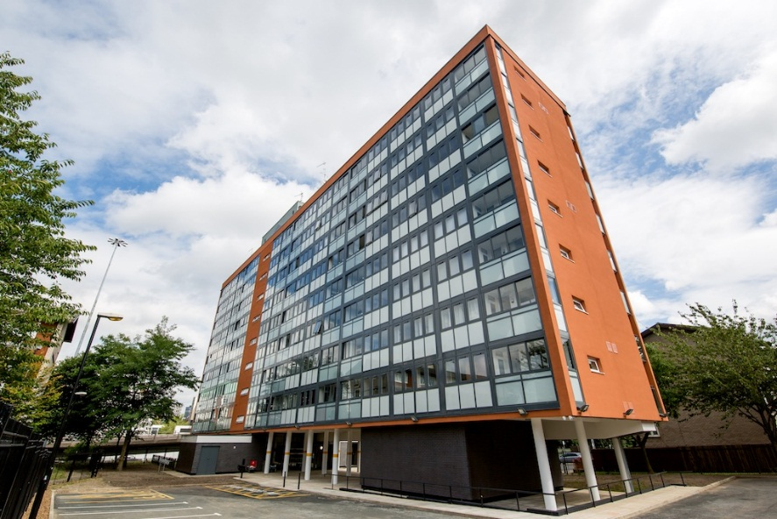
Refurbishment works
Lockton Court improvement works

Slide 7
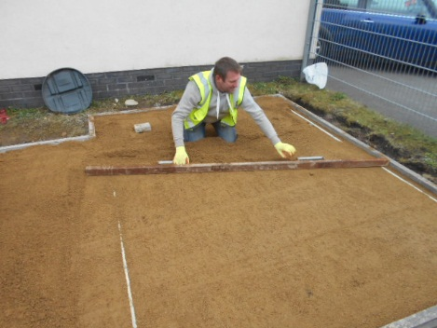
Refurbishment works
The independent certifier inspects the standard and quality then signs off the works,
Mears carefully monitor each stage of the works to ensure all works are completed correctly and in a timely manner,
All our site contractors and Customer Care Officers are on hand to assist all resident during their refurbishment works.

Slide 8

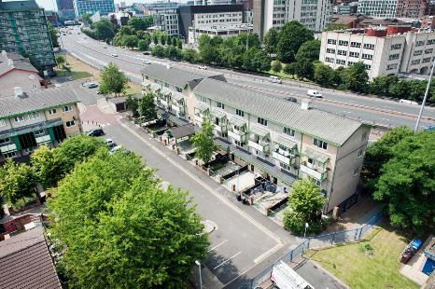
Service Charges
Your lease states that you will pay the service charge,
You must also pay towards the running and management of the building as a whole,
Covers things such as communal repairs, grounds maintenance, cyclical fund etc.
Notes:
List of what service charge covers in info pack.

Slide 9
Payment towards works
Cost of improvements per home ranges from £19, 615.32- £40,031.04
Costs to each household is capped at £10,000
All works contribute to wider regeneration of Brunswick.
Notes:
Highlight that although paying £10K towards regeneration, this is resulting in much higher property prices per previous slide- it’s a small outlay for the added value it is bringing to their property and potential sale price.
Also discuss how may be paying for things that don’t seem relevant or affect your property but part of communal, overall regen.

Slide 10

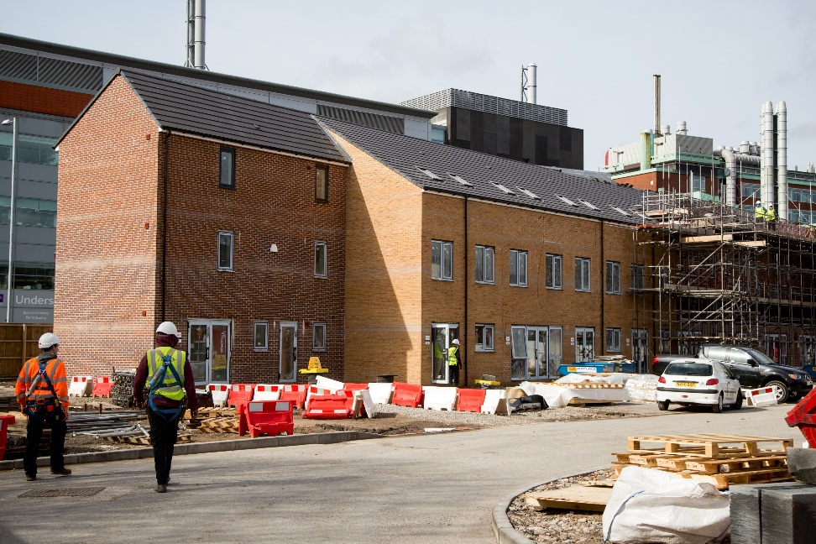
Payment options
You can spread the cost, interest free, over 5 years (£2K per year),
Or use the equity from your home to pay,
Or pay a lump sum,
Failure to pay may result in you being taken to Court!
Speak to Saba about the best way for you to pay your service charge.
Advice and support on financial matters is also available to leaseholders through our Financial Inclusion Officer.
Notes:
FIO can help leaseholders.

Slide 11
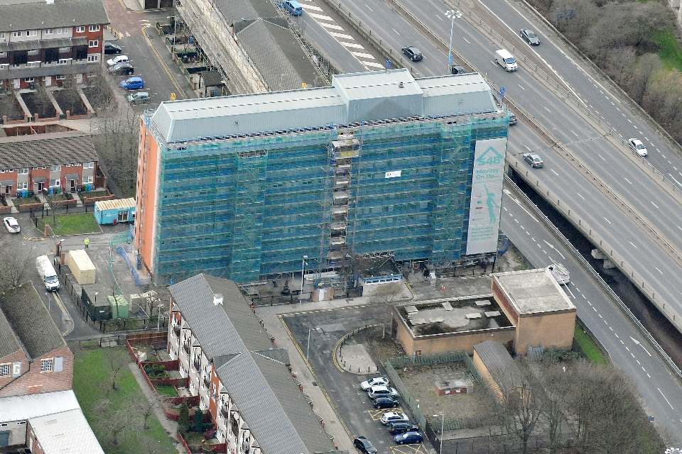
Ways to pay
Direct Debit
Standing Order
Payment Card
By Phone
Online
Post
Speak to Saba about ways to pay. If you need help to make your service charge payments you can speak to our Financial Inclusion Officer, Yvette Brown. Ask Saba for details.

Slide 12

There for you
S4B manage your lease on behalf of the Manchester City Council. S4B has dedicated team to look after you;
Saba Mirza- Leasehold Officer
Rebecca Burke- Income Management Team Leader
Both are based at the S4B Housing office on Brunswick.
We want to hear your voice!
Email, telephone, Tweet, Facebook or arrange an appointment with us,
Attend the regular leaseholder events and forums,
Complete the satisfaction surveys in you info packs and hand them in.

Slide 13

Contact Us
0300 555 0128
S4B Housing office, Bramwell Drive
info@S4Bmanchester.co.uk
repairs@S4Bmanchester.co.uk (communal repairs only)
www.s4bmanchester.co.uk
Saba 07734 879218
Rebecca 07734879207
Tweet us @S4Bmanchester
Facebook- search for S4B Manchester

Slide 14

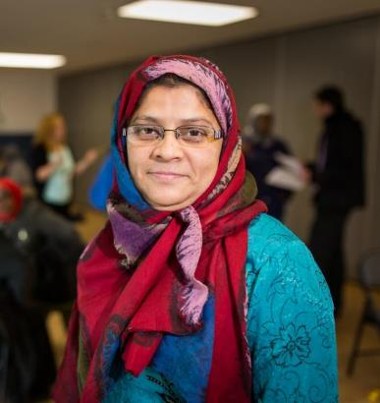

Q & A with panel

Slide 15
Thank you for coming
Please complete the short feedback survey so we can better tailor these events to your needs in the future.
Every completed survey will be entered into a prize draw to win a £20 High Street shopping voucher!

